Slide 1

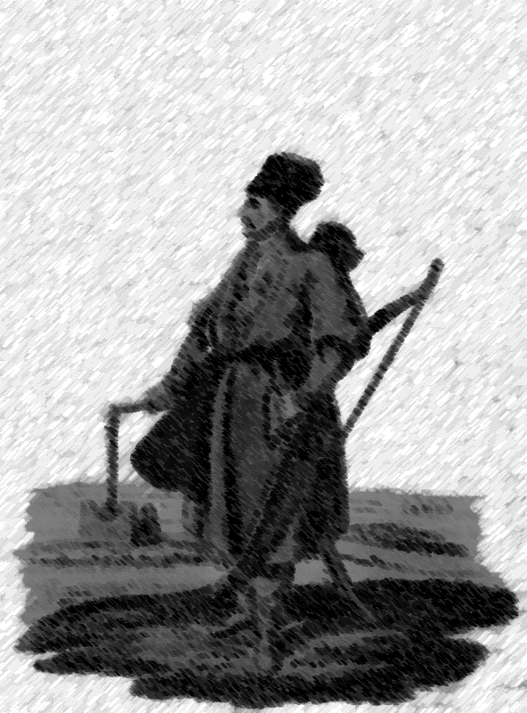
This is a Turcoman. He can be your enemy or your friend. I don’t know.
This text can be your enemy, too. I don’t know.
What the hell do I know.
Damn, but I gotta know something.

Slide 2
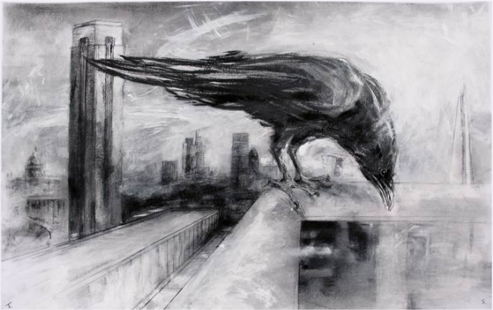

Slide 3
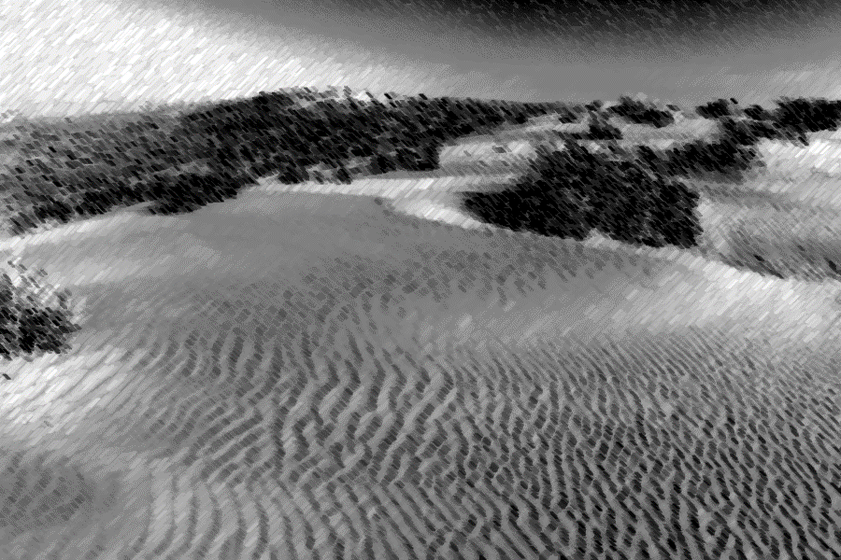

Slide 4


This is a Turcoman. He can be your enemy or your friend. I don’t know.
This text can be your enemy, too. I don’t know.
What the hell do I know.
Damn, but I gotta know something.
Will this be a good UI?
Fk… I don’t know…
Let’s hope it is…
Notes:
When passage is complete, “book flipping” occurs.

Slide 5

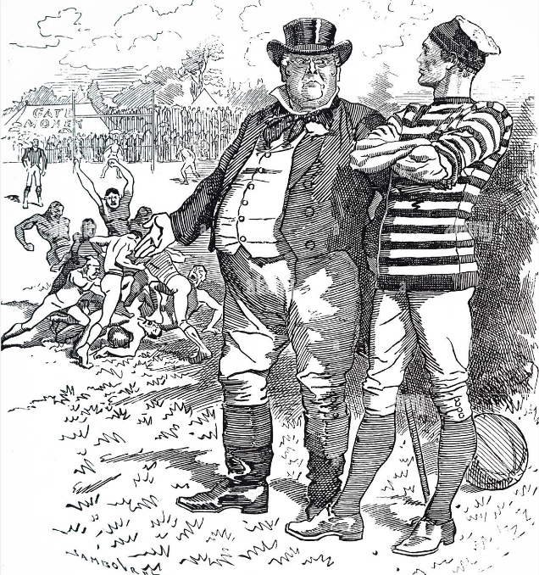
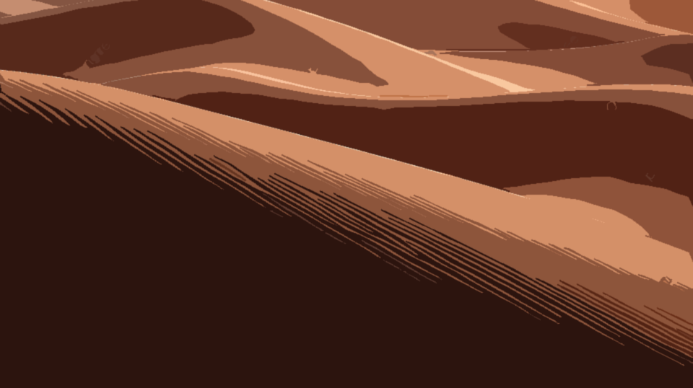

Slide 6
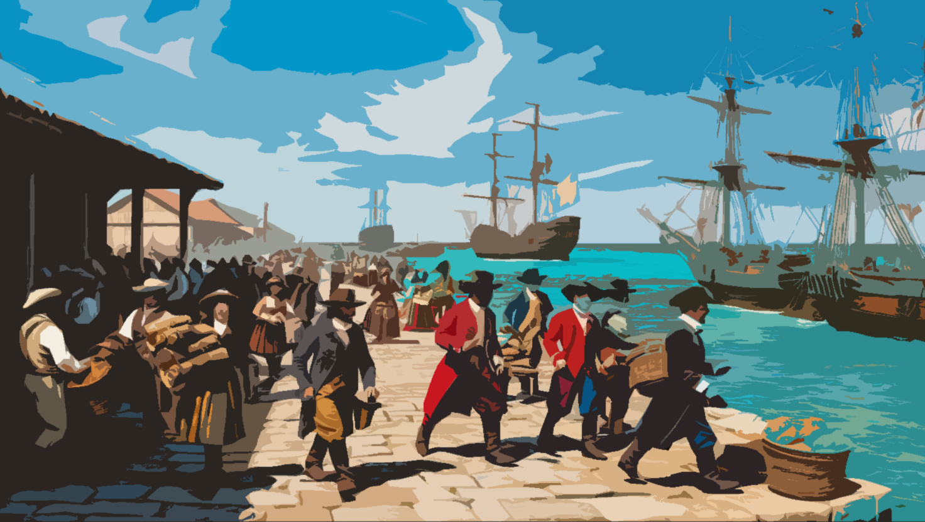
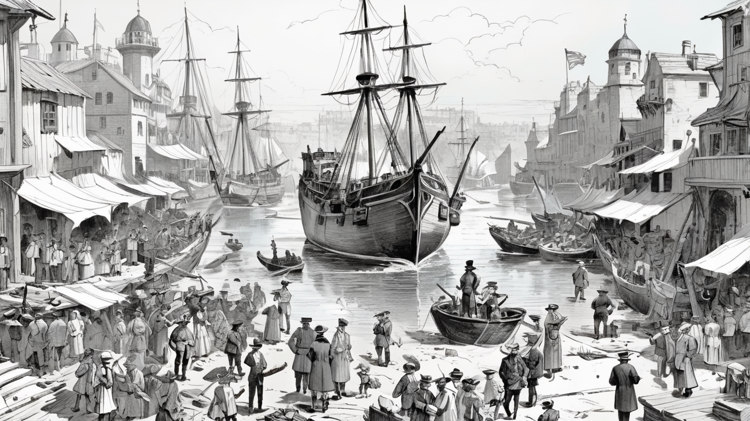
This is a Turcoman. He can be your enemy or your friend. I don’t know.
This text can be your enemy, too. I don’t know.
What the hell do I know.
Damn, but I gotta know something.
Will this be a good UI?
Fk… I don’t know…
Let’s hope it is…

Slide 7

This is a Turcoman. He can be your enemy or your friend. I don’t know.
This text can be your enemy, too. I don’t know.
What the hell do I know.
Damn, but I gotta know something.
Will this be a good UI?
Fk… I don’t know…
Let’s hope it is…

Slide 8
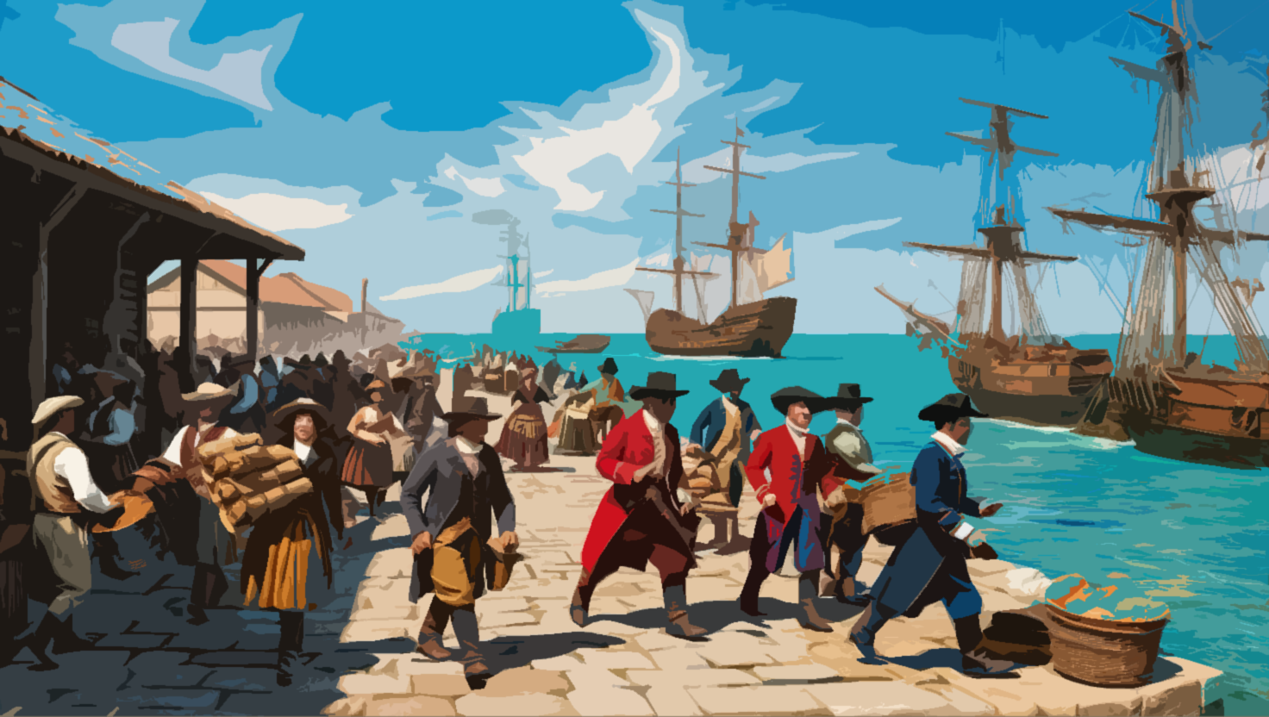
This is a Turcoman. He can be your enemy or your friend. I don’t know.
This text can be your enemy, too.
I don’t know.
What the hell do I know.
Damn, but I gotta know something.
Will this be a good UI?
Fk… I don’t know…
Let’s hope it is…

Slide 9
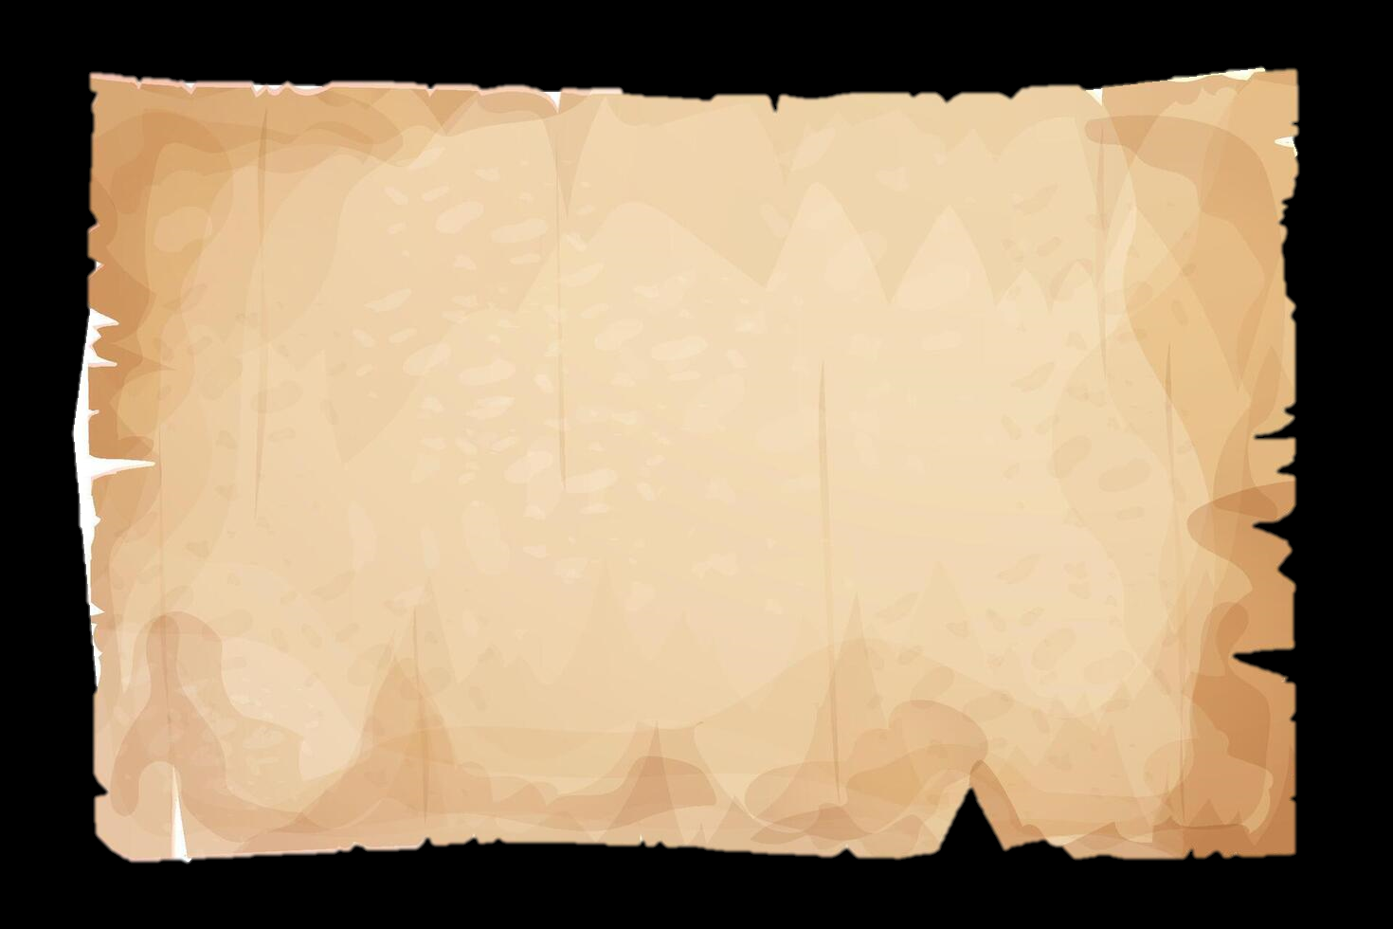
This is a Turcoman. He can be your enemy or your friend. I don’t know.
This text can be your enemy, too.
I don’t know.
What the hell do I know.
Damn, but I gotta know something.
Will this be a good UI?
Fk… I don’t know…
Let’s hope it is…
Notes:
이걸로 해보자
하… 그런데 어케 구현하냐… 머리 아프누…

Slide 10
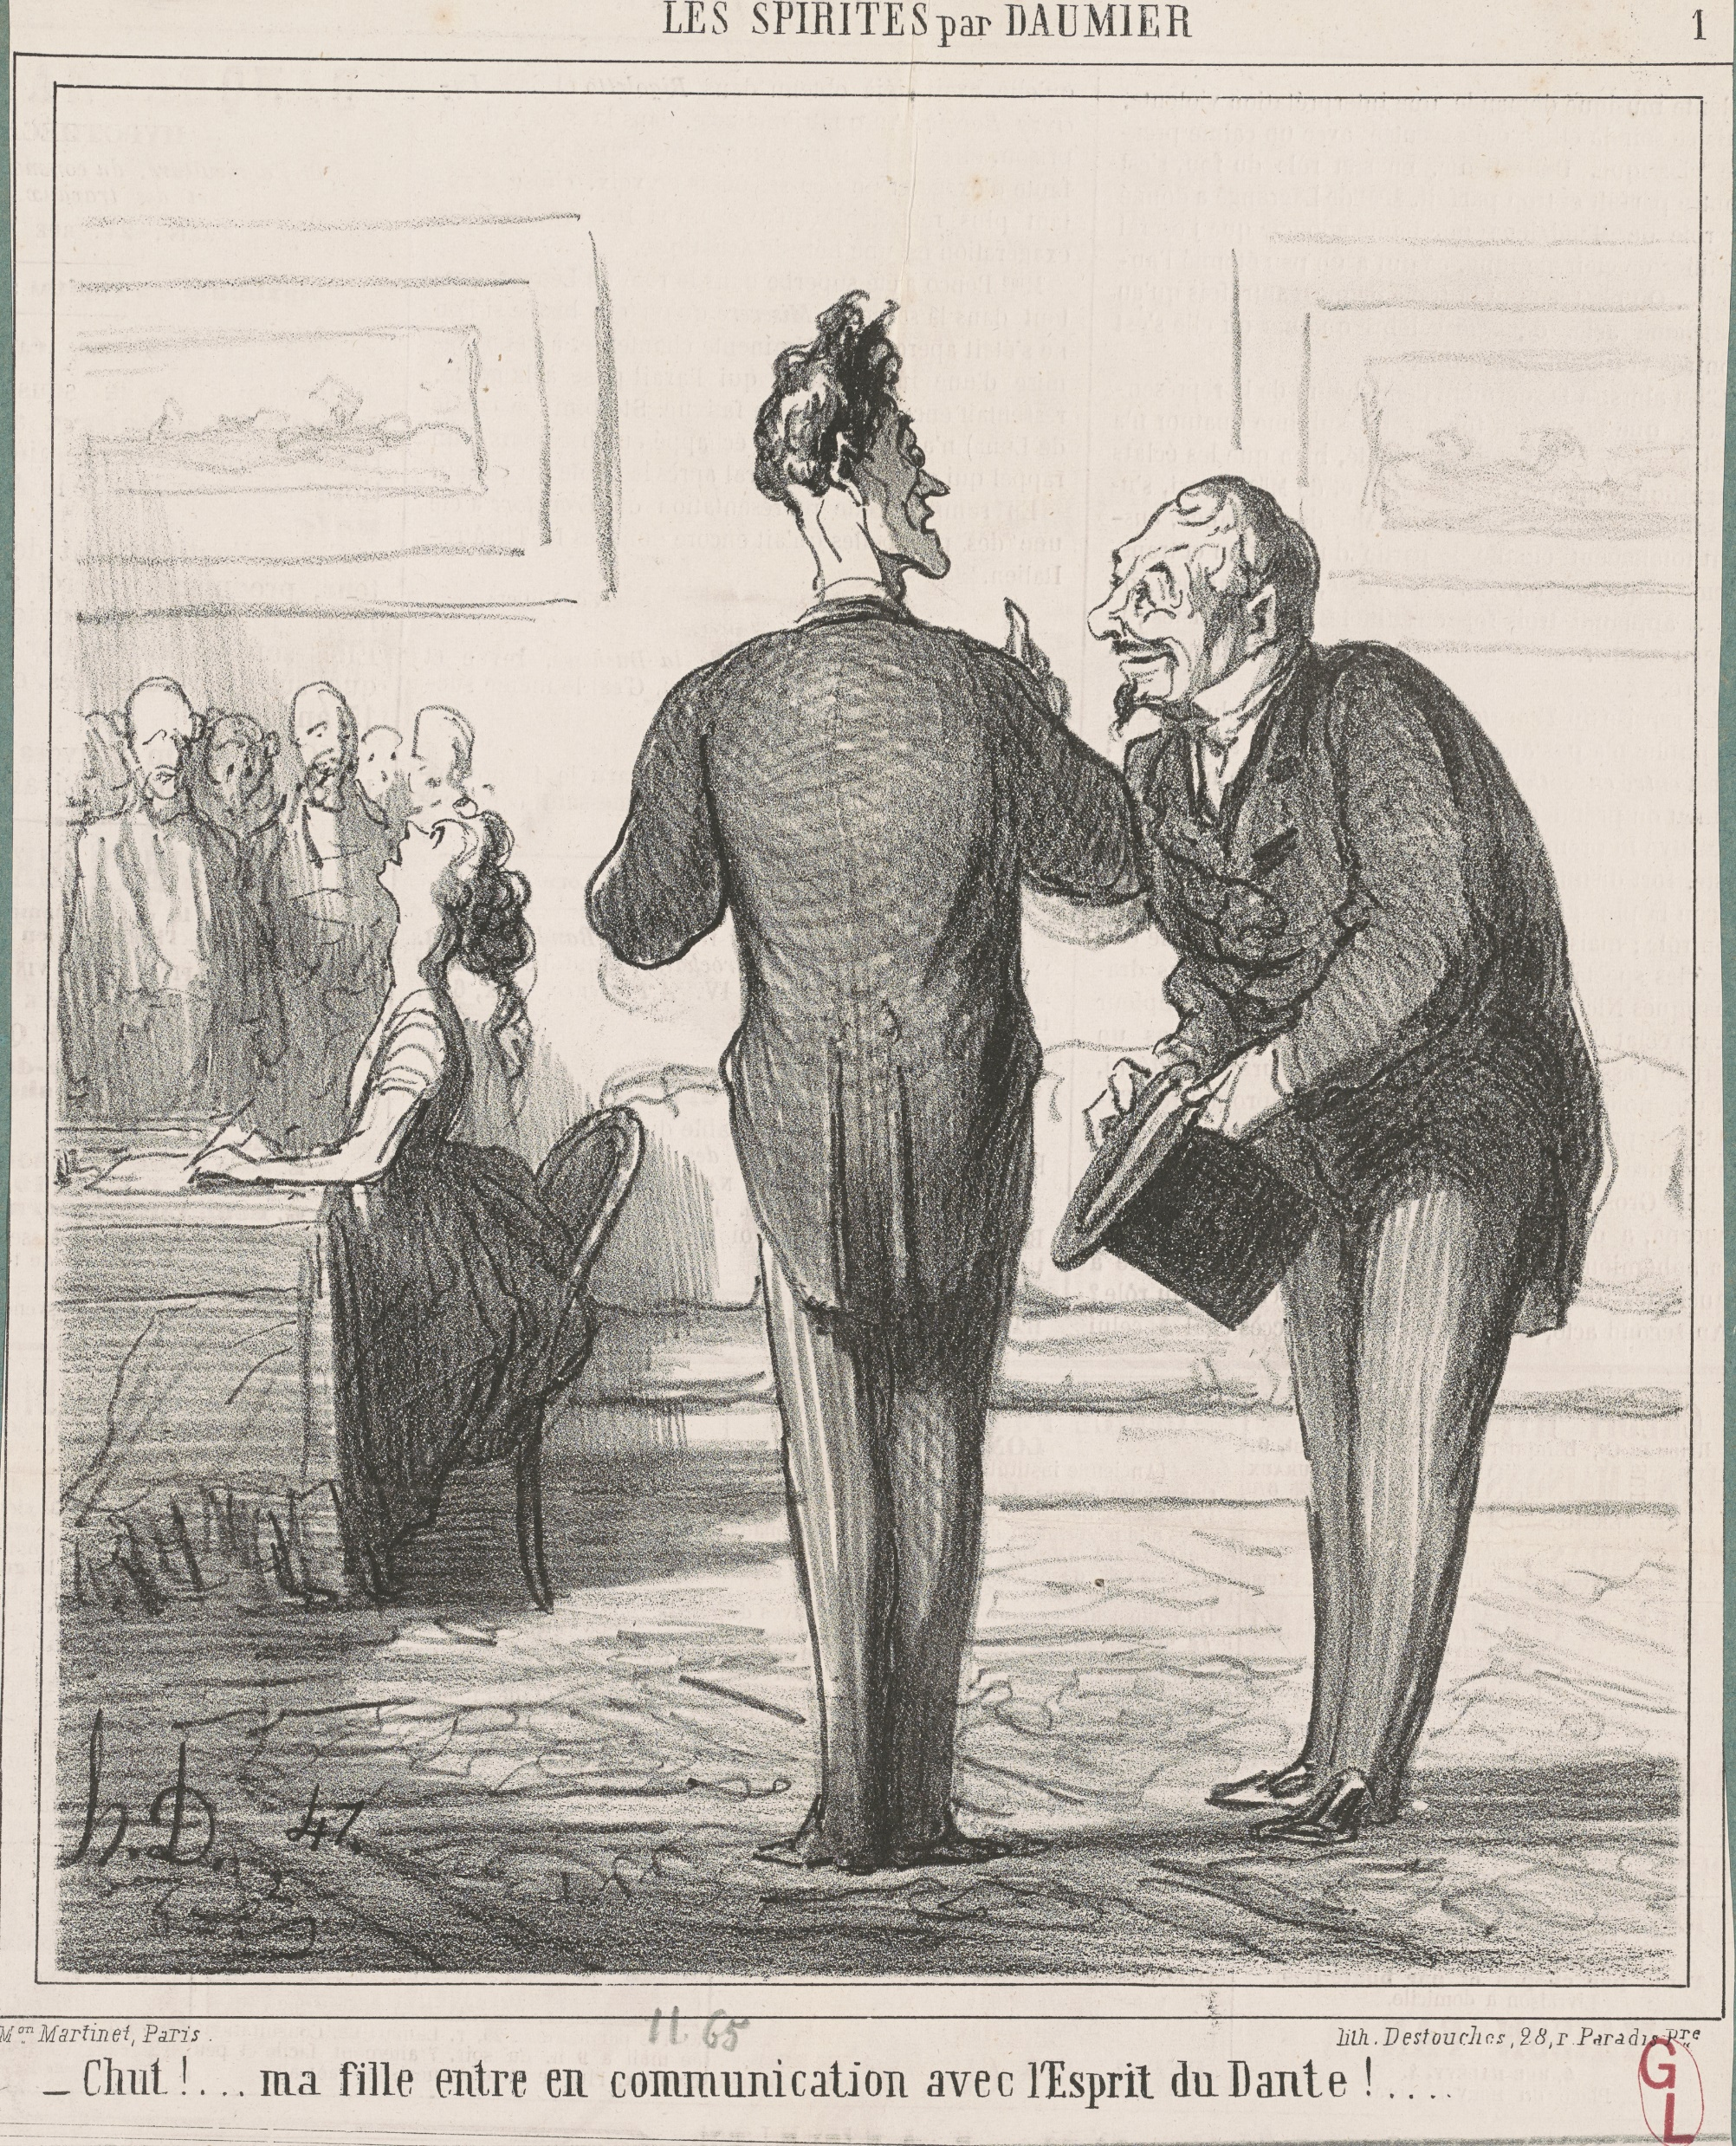

Slide 11
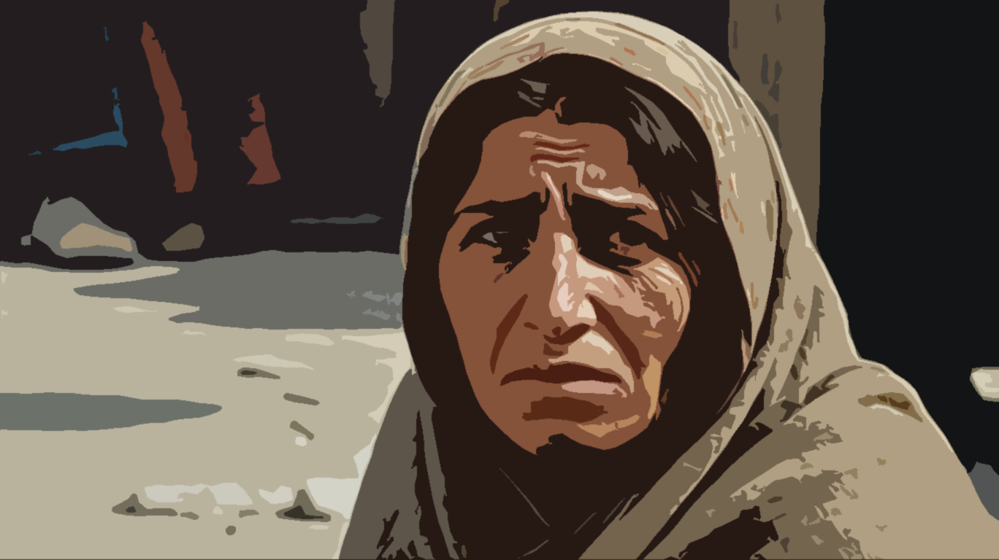

Slide 12
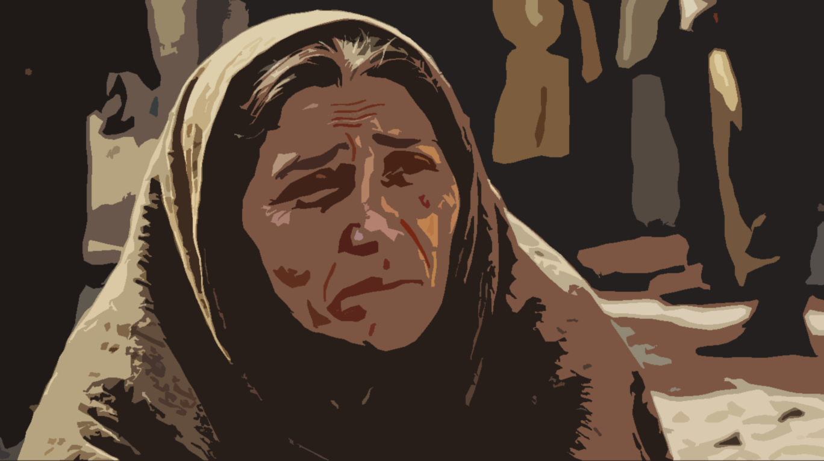

Slide 13
